Slide 1
The Relational Model

Slide 2


Data Models
DBMS models real world
Data Model is link between user’s view of the world and bits stored in computer
Student(sid:Students(sid: string, name: string, login: string, age: integer, gpa:real)
1010111101

Slide 3
Why Study the Relational Model?
Most widely used model.
  Vendors: IBM, Microsoft, Oracle, Sybase, etc.
“Legacy systems” in older models
  e.g., IBM’s IMS
Object-oriented concepts have recently merged in
  object-relational model
    IBM DB2, Oracle 9i, IBM Informix
  Based on POSTGRES research project at Berkeley
    Postgres still represents the cutting edge on some of these features!

Slide 4
Relational Database: Definitions
Relational database: a set of relations.
Relation: made up of 2 parts:
  Instance : a table, with rows and columns.
    #rows = cardinality
  Schema : specifies name of relation, plus name and type of each column.
    E.g. Students(sid: string, name: string, login: string, age: integer, gpa: real)
    #fields = degree / arity
Can think of a relation as a set of rows or tuples.
  i.e., all rows are distinct

Slide 5
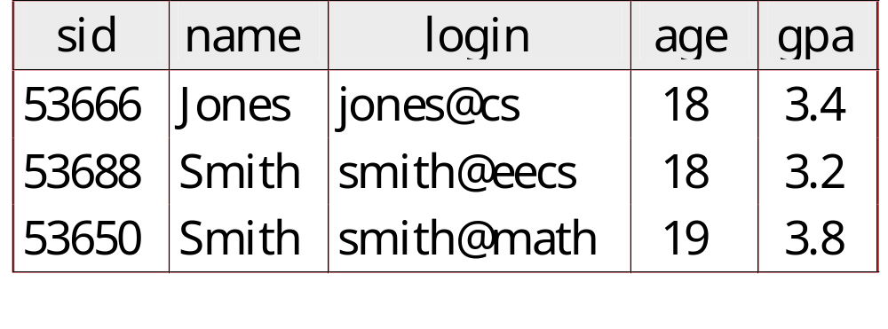
Example Instance of Students Relation
Cardinality = 3, arity = 5 , all rows distinct
Do all values in each column of a relation instance
have to be distinct?

Slide 6
SQL - A language for Relational DBs
SQL: standard language
Data Definition Language (DDL)
  create, modify, delete relations
  specify constraints
  administer users, security, etc.
Data Manipulation Language (DML)
  Specify queries to find tuples that satisfy criteria
  add, modify, remove tuples

Slide 7
SQL Overview
CREATE TABLE <name> ( <field> <domain>, … )
INSERT INTO <name> (<field names>)
VALUES (<field values>)
DELETE FROM <name>
WHERE <condition>
UPDATE <name>
SET <field name> = <value>
WHERE <condition>
SELECT <fields>
FROM <name>
WHERE <condition>

Slide 8
Creating Relations in SQL
Creates the Students relation.
Note: the type (domain) of each field is specified, and enforced by the DBMS
  whenever tuples are added or modified.
Another example: the Enrolled table holds information about courses students take.
CREATE TABLE Students
(sid CHAR(20),
name CHAR(20),
login CHAR(10),
age INTEGER,
gpa FLOAT)
CREATE TABLE Enrolled
(sid CHAR(20),
cid CHAR(20),
grade CHAR(2))

Slide 9
Adding and Deleting Tuples
Can insert a single tuple using:
INSERT INTO Students (sid, name, login, age, gpa)
VALUES (‘53688’, ‘Smith’, ‘smith@ee’, 18, 3.2)
Can delete all tuples satisfying some condition (e.g., name = Smith):
DELETE
FROM Students S
WHERE S.name = ‘Smith’
Powerful variants of these commands are available;
more later!

Slide 10
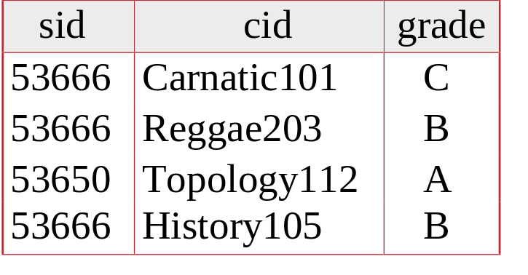
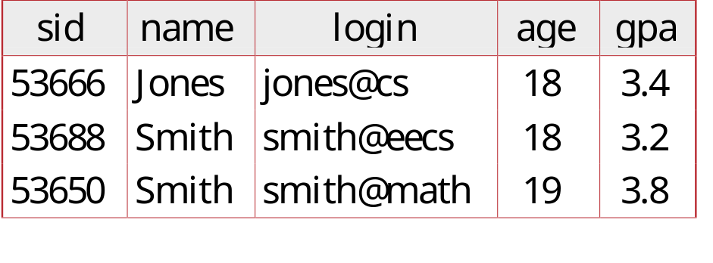
Keys
Keys are a way to associate tuples in different relations
Keys are one form of integrity constraint (IC)
Enrolled
Students

Slide 11
Primary Keys
A set of fields is a superkey if:
  No two distinct tuples can have same values in all key fields
A set of fields is a key for a relation if :
  It is a superkey
  No subset of the fields is a superkey
>1 key for a relation?
  one of the keys is chosen (by DBA) to be the primary key.
E.g.
  sid is a key for Students.
  What about name?
  The set {sid, gpa} is a superkey.

Slide 12
Primary and Candidate Keys in SQL
Possibly many candidate keys (specified using UNIQUE), one of which is chosen as the primary key.
“For a given student and course, there is a single grade.”
vs.
“Students can take only one course, and receive a single grade for that course; further, no two students in a course receive the same grade.”
Used carelessly, an IC can prevent the storage of database instances that should arise in practice!
CREATE TABLE Enrolled
(sid CHAR(20)
cid CHAR(20),
grade CHAR(2),
PRIMARY KEY (sid,cid))
CREATE TABLE Enrolled
(sid CHAR(20)
cid CHAR(20),
grade CHAR(2),
PRIMARY KEY (sid),
UNIQUE (cid, grade))

Slide 13
Foreign Keys
A Foreign Key is a field whose values are keys in another relation.
Enrolled
Students

Slide 14
Foreign Keys, Referential Integrity
Foreign key : Set of fields in one relation that is used to `refer’ to a tuple in another relation.
  Must correspond to primary key of the second relation.
  Like a `logical pointer’.
E.g. sid is a foreign key referring to Students:
  Enrolled(sid: string, cid: string, grade: string)
  If all foreign key constraints are enforced, referential integrity is achieved (i.e., no dangling references.)

Slide 15
Foreign Keys in SQL
Only students listed in the Students relation should be allowed to enroll for courses.
CREATE TABLE Enrolled
(sid CHAR(20), cid CHAR(20), grade CHAR(2),
PRIMARY KEY (sid,cid),
FOREIGN KEY (sid) REFERENCES Students )
Enrolled
Students

Slide 16
Integrity Constraints (ICs)
IC: condition that must be true for any instance of the database; e.g., domain constraints.
  ICs are specified when schema is defined.
  ICs are checked when relations are modified.
A legal instance of a relation is one that satisfies all specified ICs.
  DBMS should not allow illegal instances.
If the DBMS checks ICs, stored data is more faithful to real-world meaning.
  Avoids data entry errors, too!

Slide 17
Where do ICs Come From?
ICs are based upon the semantics of the real-world that is being described in the database relations.
We can check a database instance to see if an IC is violated, but we can NEVER infer that an IC is true by looking at an instance.
  An IC is a statement about all possible instances!
  From example, we know name is not a key, but the assertion that sid is a key is given to us.
Key and foreign key ICs are the most common; more general ICs supported too.

Slide 18
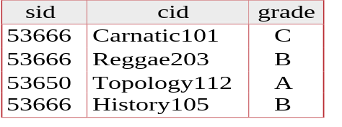
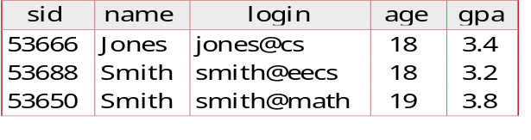
Enforcing Referential Integrity
Enrolled
Students
Remember Students and Enrolled; sid in Enrolled is a foreign key that references Students.
What should be done if an Enrolled tuple with a non-existent student id is inserted?
  (Reject it!)
What should be done if a Students tuple is deleted?
  Also delete all Enrolled tuples that refer to it.
  Disallow deletion of a Students tuple that is referred to.
  Set sid in Enrolled tuples that refer to it to a default sid.
  (In SQL, also: Set sid in Enrolled tuples that refer to it to a special value null, denoting `unknown’ or `inapplicable’.)
Similar if primary key of Students tuple is updated.

Slide 19
Relational Query Languages
A major strength of the relational model: supports simple, powerful querying of data.
Queries can be written intuitively, and the DBMS is responsible for efficient evaluation.
  The key: precise semantics for relational queries.
  Allows the optimizer to extensively re-order operations, and still ensure that the answer does not change.

Slide 20
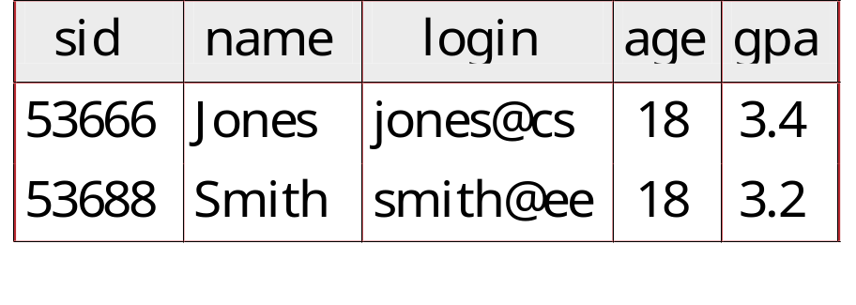
The SQL Query Language
The most widely used relational query language.
  Current std is SQL99; SQL92 is a basic subset
To find all 18 year old students, we can write:
SELECT *
FROM Students S
WHERE S.age=18
To find just names and logins, replace the first line:
SELECT S.name, S.login

Slide 21
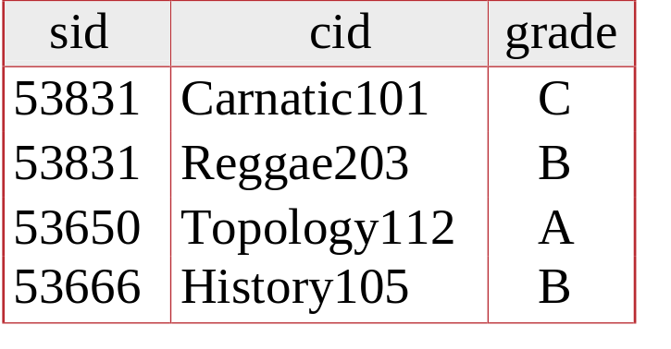
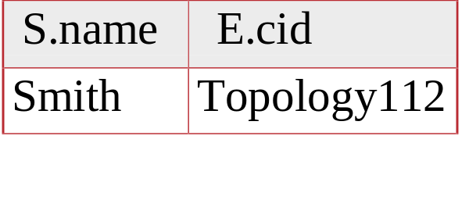
Querying Multiple Relations
What does the following query compute?
SELECT S.name, E.cid
FROM Students S, Enrolled E
WHERE S.sid=E.sid AND E.grade='A'
Given the following instance of Enrolled
we get:

Slide 22
Semantics of a Query
A conceptual evaluation method for the previous query:
  1. do FROM clause: compute cross-product of Students and Enrolled
  2. do WHERE clause: Check conditions, discard tuples that fail
  3. do SELECT clause: Delete unwanted fields
Remember, this is conceptual. Actual evaluation will be much more efficient, but must produce the same answers.

Slide 23
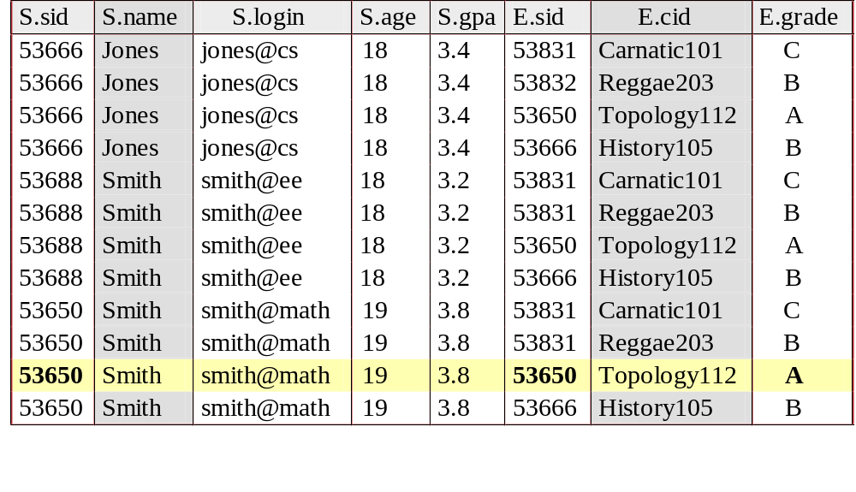
Cross-product of Students and Enrolled Instances

